Slide 1

Week 08
Friday 28th May

Slide 2
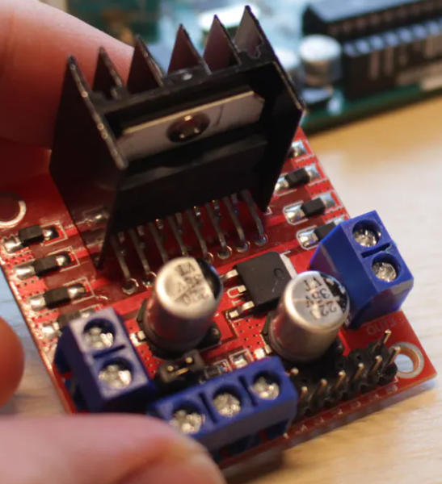

L298 Motor Driver

Slide 3
Do the wires fall out of your motor driver?
There is a special way to insert them.

Slide 4
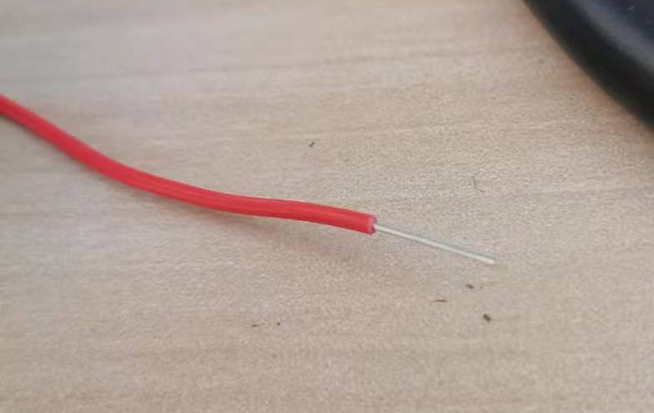

Slide 5
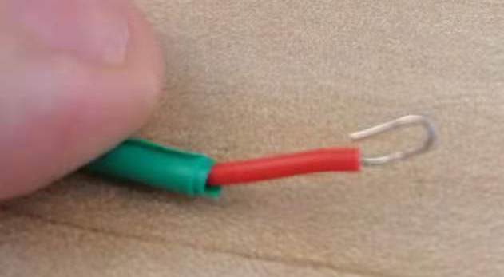

Slide 6
Sensors
Let’s talk about sensors

Slide 7
Sensors
So far, on our little robot car, we have installed two types of analog sensors. We have the 3 IR sensors to follow the line, and we have the 2 LDR sensors to detect light, luckily our Arduino has 6 analog pins, right?
But in the real world we will need to do a lot more than that. We need to measure things such as air pressure and humidity (how much water is in the air). We need to check if the robot is on a slope going up or down. Maybe one side of the robot is raised higher than the other.
There are many types of sensors we could use. Today we are going to look at some fairly common ones.

Slide 8
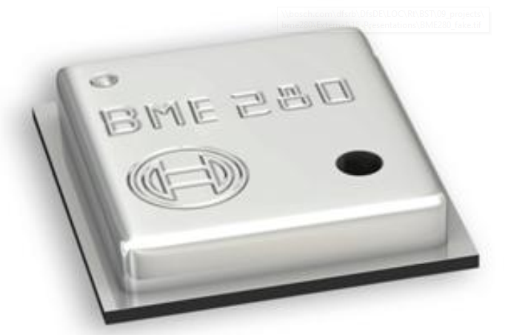
BME 280
This sensor is made by Bosch, it can measure temperature, air pressure and humidity. It is a single package with 3 sensors onboard.
It is a very commonly used sensor in weather stations and for home appliances. It can be used in some simple medical equipment too.

Slide 9
Why is this relevant? Well, you can use it to do simple weather estimation. You can make your robot reduce it’s speed in wet conditions.
Maybe you want your robot to stop/start the motors when you breathe on the sensor. (Our breath contains a lot of moisture, so it quickly raises humidity).
You could have the robot move towards areas of high humidity, so the robot can find a water source.
As for the air pressure sensor – if it is precise enough you can use it to estimate the height above sea level. You can check if the height has raised or lowered since the robot was activated.
You can have the robot move towards/away from areas of high temperature, or see if the motor is overheating.

Slide 10
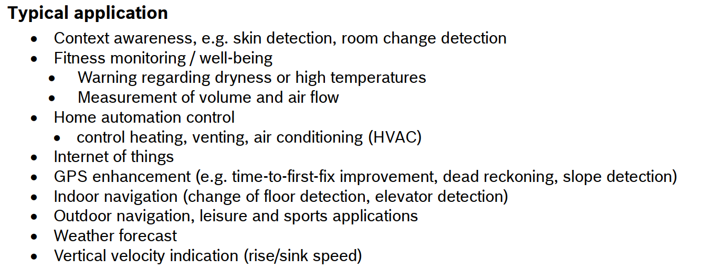

Slide 11
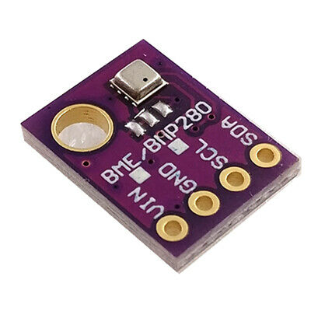
In our robot kit we have a board with this sensor on it. We need to solder the header pins to it before we can use it.
We will talk about the pins later in the lecture.

Slide 12
Using changing air pressure is a good method to determine height, making the robot stop the engines when you lift it up. But you need to lift it quite high to do that. And due to environmental variables it may trigger the robot at the wrong time.
A better method would be to use an accelerometer. This is used to measure acceleration in different directions. You have them in your phone and many other devices.

Slide 13
Accelerometer
An accelerometer works using an electromechanical sensor that is designed to measure either static or dynamic acceleration. Static acceleration is the constant force acting on a body, like gravity or friction. These forces are predictable and uniform to a large extend. For example, the acceleration due to gravity is constant at 9.8m/s, and the gravitation force is almost the same at every point on earth.
Dynamic acceleration forces are non-uniform, and the best example is vibration or shock. A car crash is an excellent example of dynamic acceleration. Here, the acceleration change is sudden when compared to its previous state. The theory behind accelerometers is that they can detect acceleration and convert it into measurable quantities like electrical signals.

Slide 14
We will be using a 3-axis accelerometer. It can measure acceleration moving forwards/backwards (x-axis), side-to-side (y-axis) and up/down (z-axis).
Remember, when the robot is steady, there is a constant acceleration downwards because of gravity. If the car is rolling over, the different sensors will read different accelerations due to gravity.
If the robot is falling the y-axis will read 0 acceleration. If the robot is picked up, the robot will read a high y-acceleration. If the robot is lowered to the ground (or going down a slope) the robot will read a low y-axis acceleration.

Slide 15
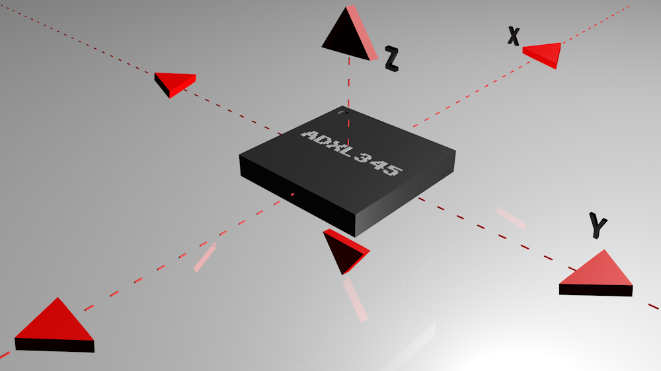

Slide 16
Gyroscope
Gyroscope sensor is a device that can measure and maintain the orientation and angular velocity of an object. These are more advanced than accelerometers. These can measure the tilt and lateral orientation of the object whereas accelerometer can only measure the linear motion.
Gyroscope sensors are also called as Angular Rate Sensor or Angular Velocity Sensors. These sensors are installed in the applications where the orientation of the object is difficult to sense by humans.
Measured in degrees per second, angular velocity is the change in the rotational angle of the object per unit of time.

Slide 17
Besides sensing the angular velocity, Gyroscope sensors can also measure the motion of the object. For more robust and accurate motion sensing, in consumer electronics Gyroscope sensors are combined with Accelerometer sensors.
Depending on the direction there are three types of angular rate measurements.
Yaw- the horizontal rotation on a flat surface when seen the object from above,
Pitch- Vertical rotation as seen the object from front,
Roll- the horizontal rotation when seen the object from front.

Slide 18
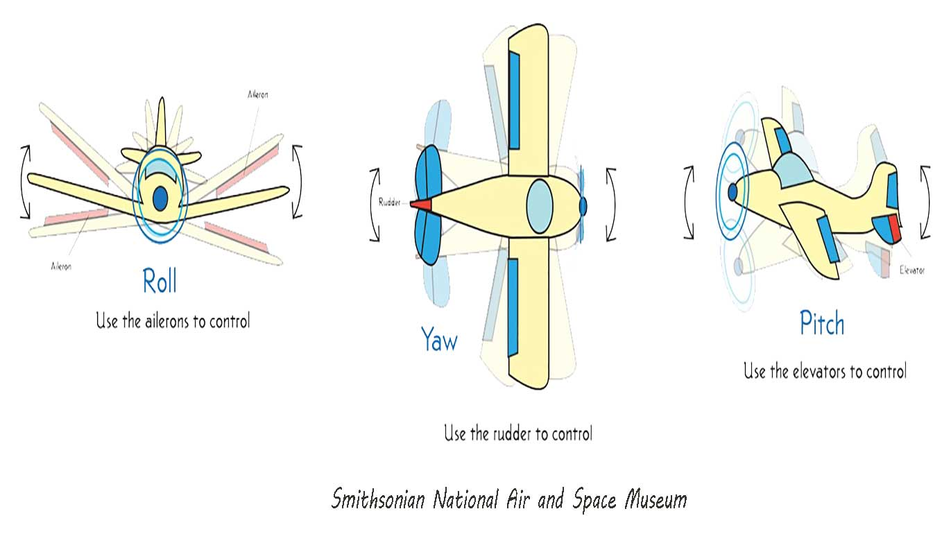

Slide 19

A gyroscope is very useful in our robot, because we can easily detect if our robot is on a slope, or if it has been picked up.

Slide 20
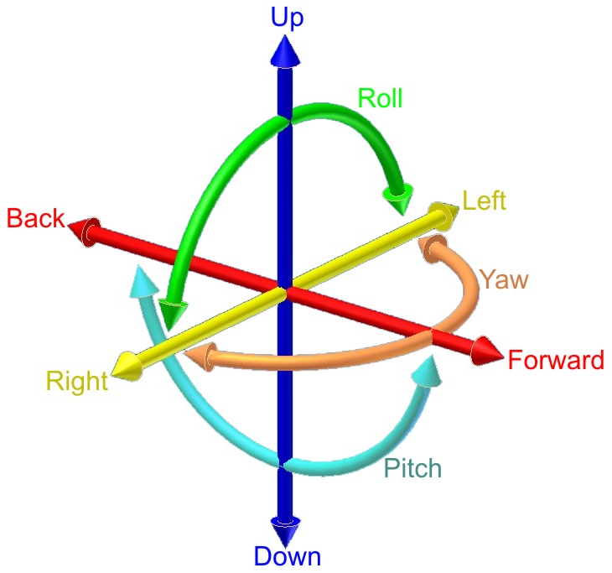
We have 2 sensors with a total of 6 axis. We can measure 3 axis of acceleration and 3 axis of angles.

Slide 21
Magnetometer
A magnetometer is a scientific instrument used to measure the strength and direction of the magnetic field in the vicinity of the instrument. Magnetism varies from place to place because of differences in Earth’s magnetic field caused by the differing nature of rocks and the interaction between charged particles from the sun and the magnetosphere of a planet.
Magnetometers are used in geophysical surveys to find deposits of iron because they can measure the magnetic field variations caused by the deposits. Magnetometers are also used to detect shipwrecks and other buried or submerged objects.

Slide 22
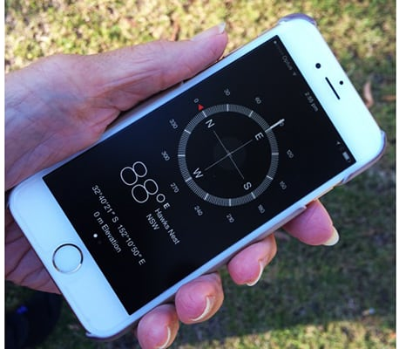
A common use for a magnetometer is as a compass. You can easily use it to determine North.
When you use it with a gyroscope and accelerometer you can accomplish many great things.

Slide 23
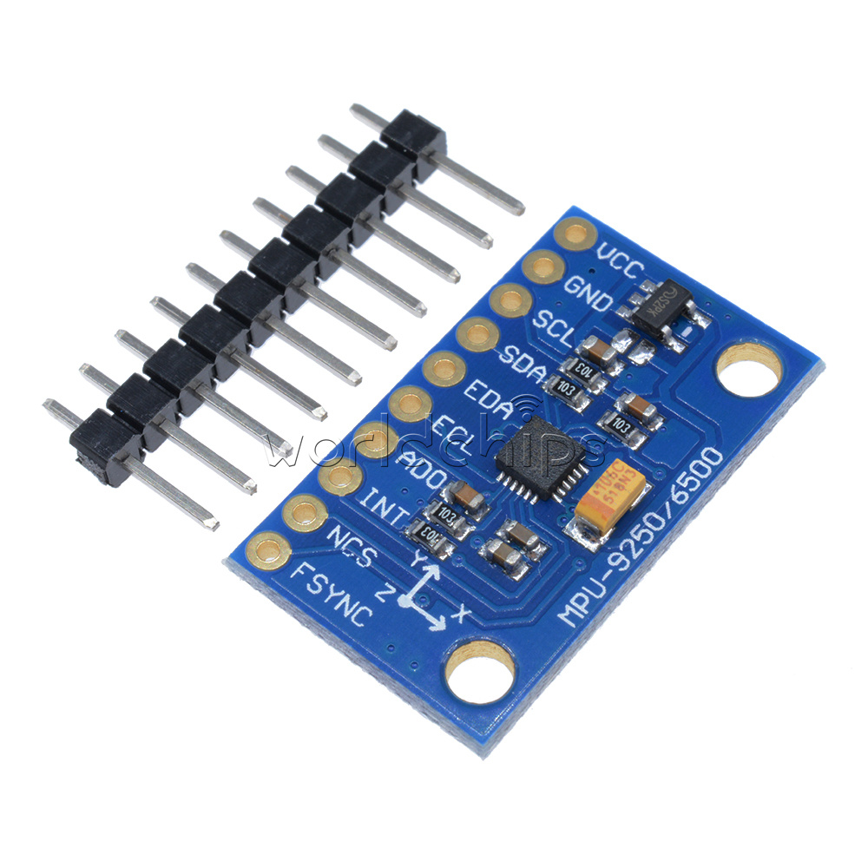
MPU-9250
This is an MPU-9250 it is a sensor module with three 3 axis sensors.
A triple-axis MEMS gyroscope
A triple-axis MEMS accelerometer
A triple-axis MEMS magnetometer
These types of sensor modules are often referred to as 9 Degrees of Freedom (9DoF) boards because they measure 9 different axis.

Slide 24
How many sensors?
Sensor | Quantity | Total
IR proximity sensor | 3 | 3
LDR light sensor | 2 | 5
Ultrasound distance sensor | 1 | 6
Air Pressure | 1 | 7
Temperature | 1 | 8
Humidity | 1 | 9
Accelerometer | 3 | 12
Gyroscope | 3 | 15
Magnetometer | 3 | 18
So, let’s count how many sensors our robot has
We have a total of 18 sensors on our car.
Our car only has 6 analog input pins….

Slide 25
Let’s look at how we use our sensors in more detail. Let’s just look at the IR sensors. (L = Left, C = Center, R = Right)
start loop
  Check sensor L
  Check sensor C
  Check sensor R
  Do some calculations
  Control the motor
repeat
We can see from this simple example that most of the time we are not looking at the sensor values. We only care about the sensor value at one stage in the program, the rest of the time it is just sitting there, useless.
If each of these sensors are connected to 1 input pin (like we are doing now), that means that most of the time those input pins are not being used.

Slide 26
Imagine the following situation: A person only has 1 pair of eyes and on the table in front of you are fifteen different types of sensors. A person can only look at one sensor.
Do you call 14 friends over so you can each watch one sensor?
Of course not.
You will use your one pair of eyes to look at each sensor one-by-one in a set pattern.
This is a much more efficient system than having many people looking at them all the time.

Slide 27
Can we do something similar with Arduino? Is there a way we can connect many different sensors to an Arduino input pin, then just look at the sensor we need to.
Yes, there is.
We will use something called a data bus, which is a way to connect many different devices using the same pins.

Slide 28
data bus
A data bus is a way of connecting lots of different devices together on the same line. There are many different types of data bus, for many different situations. Some work using a parallel connection – they send data over many connections at the same time. A cheaper method is a serial connection, sending data bit by bit down a single line.
For small scale operations like ours there are mainly 3 serial connection types that we could use: I2C, SPI and CAN.
We will use I2C for our robot.

Slide 29
Baud Rate
The baud rate specifies how fast data is sent over a serial line. It's usually expressed in units of bits-per-second (bps). If you invert the baud rate, you can find out just how long it takes to transmit a single bit. This value determines how long the transmitter holds a serial line high/low or at what period the receiving device samples its line.
Baud rates can be just about any value within reason. The only requirement is that both devices operate at the same rate. One of the more common baud rates, especially for simple stuff where speed isn't critical, is 9600 bps. Other "standard" baud are 1200, 2400, 4800, 19200, 38400, 57600, and 115200.
The higher a baud rate goes, the faster data is sent/received, but there are limits to how fast data can be transferred. You usually won't see speeds exceeding 115200 - that's fast for most microcontrollers. Get too high, and you'll begin to see errors on the receiving end, as clocks and sampling periods just can't keep up.

Slide 30
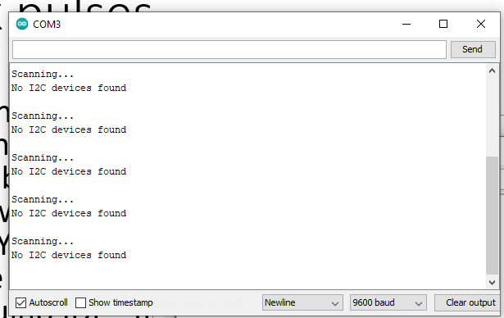
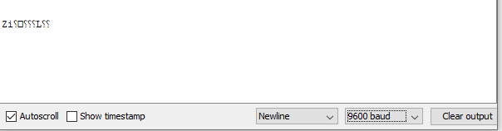
data speeds
Every kind of communication between 2 or more devices is difficult because they don’t always work at the same speed. You know yourself with the Serial Monitor on the Arduino IDE. If the Arduino is sending data at 115200 baud and our Serial monitor is set to 9600 baud then you will get garbage.

Slide 31
If we don’t use a clock (called asynchronous serial) our speed is limited and our devices all need to be set to use the same baud rate. But, baud rates are fairly low.
If we use a clock pin, we can have all of our devices connected to that single clock. This tells them when to listen to the data bus, or when to transmit. It lets them use higher data rates, and we can easily change the data rate using software.
Using a common clock is called synchronous serial.

Slide 32
example of synchronous vs asynchronous
What if we have a few devices on our data bus that all read data at 115200 baud using an asynchronous system.
We set all of our software up to use that speed, and everything works.
But then we add a new device which can only work at 74880 baud.
We can change our software easily, but the other devices might not be able to work at lower speeds. Or we may need to make changes to the actual device to tell it to use the new speed.
With a synchronous system, we just change the software. That’s it.

Slide 33
I2C
I2C or I²C stands for Inter-Integrated Circuit and is a simple way to allow over a thousand different devices to talk to the same controller. It is only designed for short-range communication, which is perfect for us.
Even better, it only uses 2 signal wires.
TWO WIRES on our Arduino can control thousands of sensors. WOW.

Slide 34
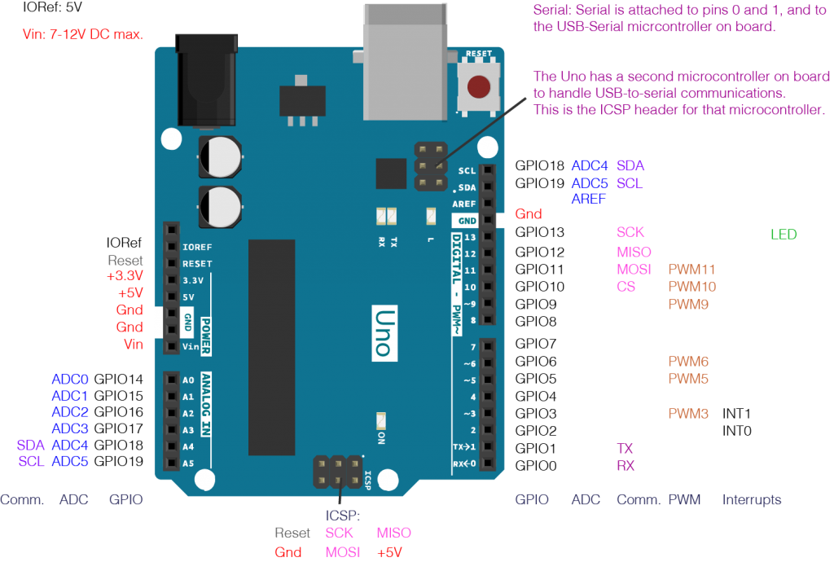

Slide 35
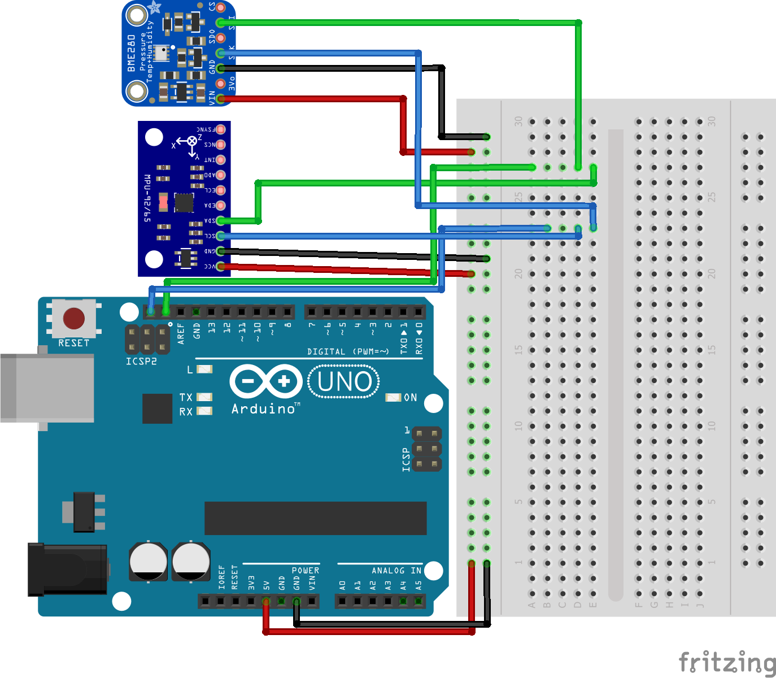
Here they are in more detail. The two pins we need for I2C are SCL and SDA. SCL is for the clock, and SDA is for the data.
Sometimes they are not labelled, so remember that SCL is the top one and SDA is below it.

Slide 36
I2C
The basics of I2C are very simple.
You connect the SDA of every device to the SDA pin of the Arduino.
You connect the SCL pin of every device to the SCL pin of the Arduino.
Devices do not send data unless they are requested to.
Each device has an individual address using hexadecimal, such as 0x68.
You send data to that address and get a response back.
Some devices call the clock SCK instead of SCL, and the data SDI instead of SDA, but they are the same thing.

Slide 37
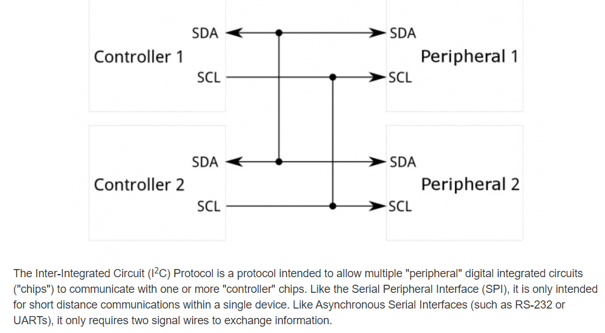

Slide 38
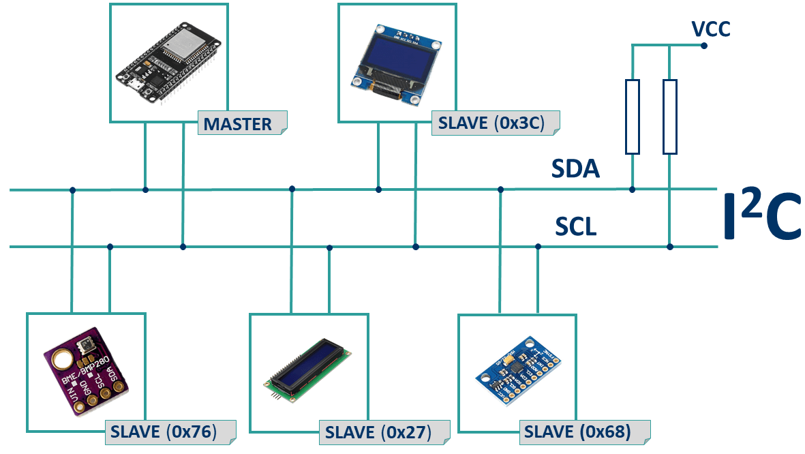

Slide 39
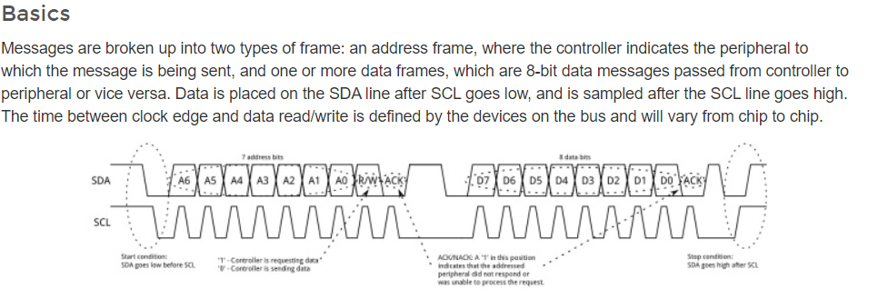

Slide 40
Detail of I2C workings
We will not investigate the detail of the workings of I2C at this stage in the course. If you are interested https://learn.sparkfun.com/tutorials/i2c/all is a good place to find out about I2C as is Wikipedia
Most devices that you connect to I2C have libraries written that means you simply have to connect the data and clock lines for each device (as well as power and ground)
When using Arduinos you need to add these libraries look at the Arduino help for how to do this if you forget

Slide 41
Connecting our new sensors using I2C
The BME280 used here looks a little different because it has more pins on it. That isn’t a problem for us because the basic functions are the same.
All of the SCL pins are connected together.
All of the SDA pins are connected together.

Slide 42
SDA
SCL

Slide 43
Using the BME 280 board with Arduino
When we have connected the sensor module to our Arduino we need our software to talk to it. We need to use the library created by the manufacturer.
Let’s look at how to add that to our Arduino…

Slide 44
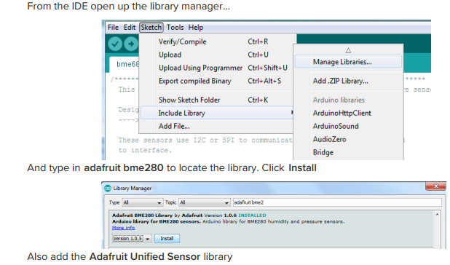

Slide 45
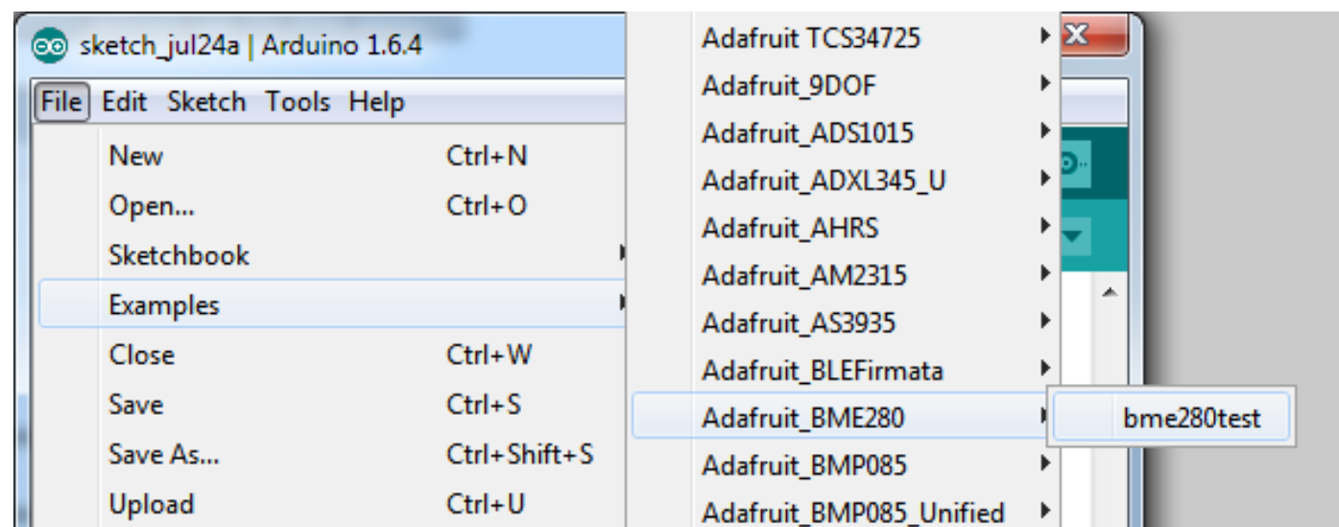
Then we can load a demo sketch to test our sensors are working.

Slide 46
Using the MPU 9250 board with Arduino
When we have connected the sensor module to our Arduino we need our software to talk to it. We need to use the library created by the manufacturer.
Let’s look at how to add that to our Arduino…

Slide 47
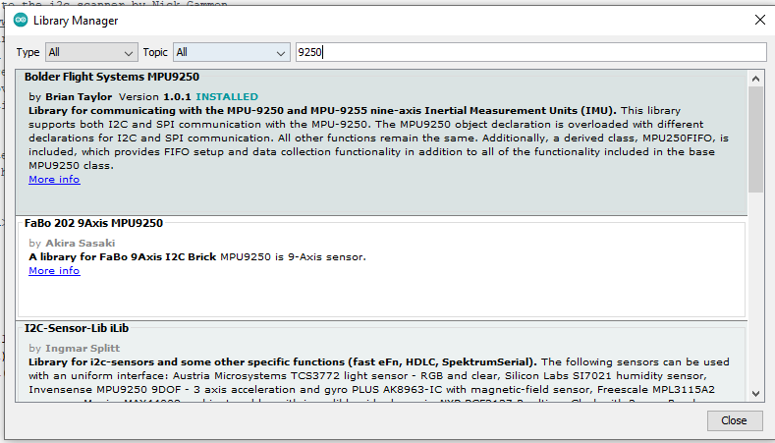

Slide 48
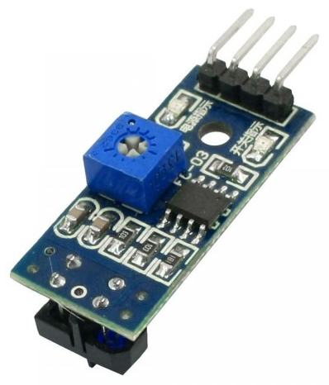
IR Sensor
Can we use I2C with our 3 IR Sensors? How about with our 2 LDR sensors?
Let’s take a look at our IR Sensor module. It has an Analog OUT (A0) and a Digital OUT (D0). Our sensor module is designed to be connected directly to an Arduino and read in real-time. It sends constant signals to the pin, even if we only sample them every loop of the code.
The Analog signal has to go through an ADC.

Slide 49
So, at first glance, it seems impossible to connect our IR module using I2C. Especially when you consider that I2C devices need to have a set address.
However, there is another option.
What if we used an external ADC, that could use I2C?

Slide 50
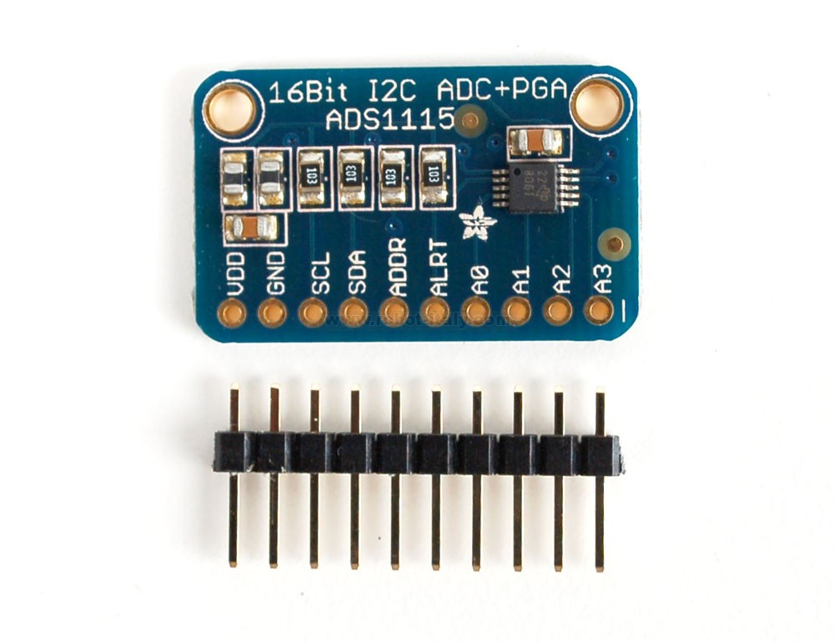
ADS1115
This is a 16bit ADC with 4 channels, that works with I2C.
We can connect different analog devices to the pins A0 to A3, then we can read them using I2C.
This board costs around 25 yuan from TaoBao. If you are interested in using them let us know.

Slide 51
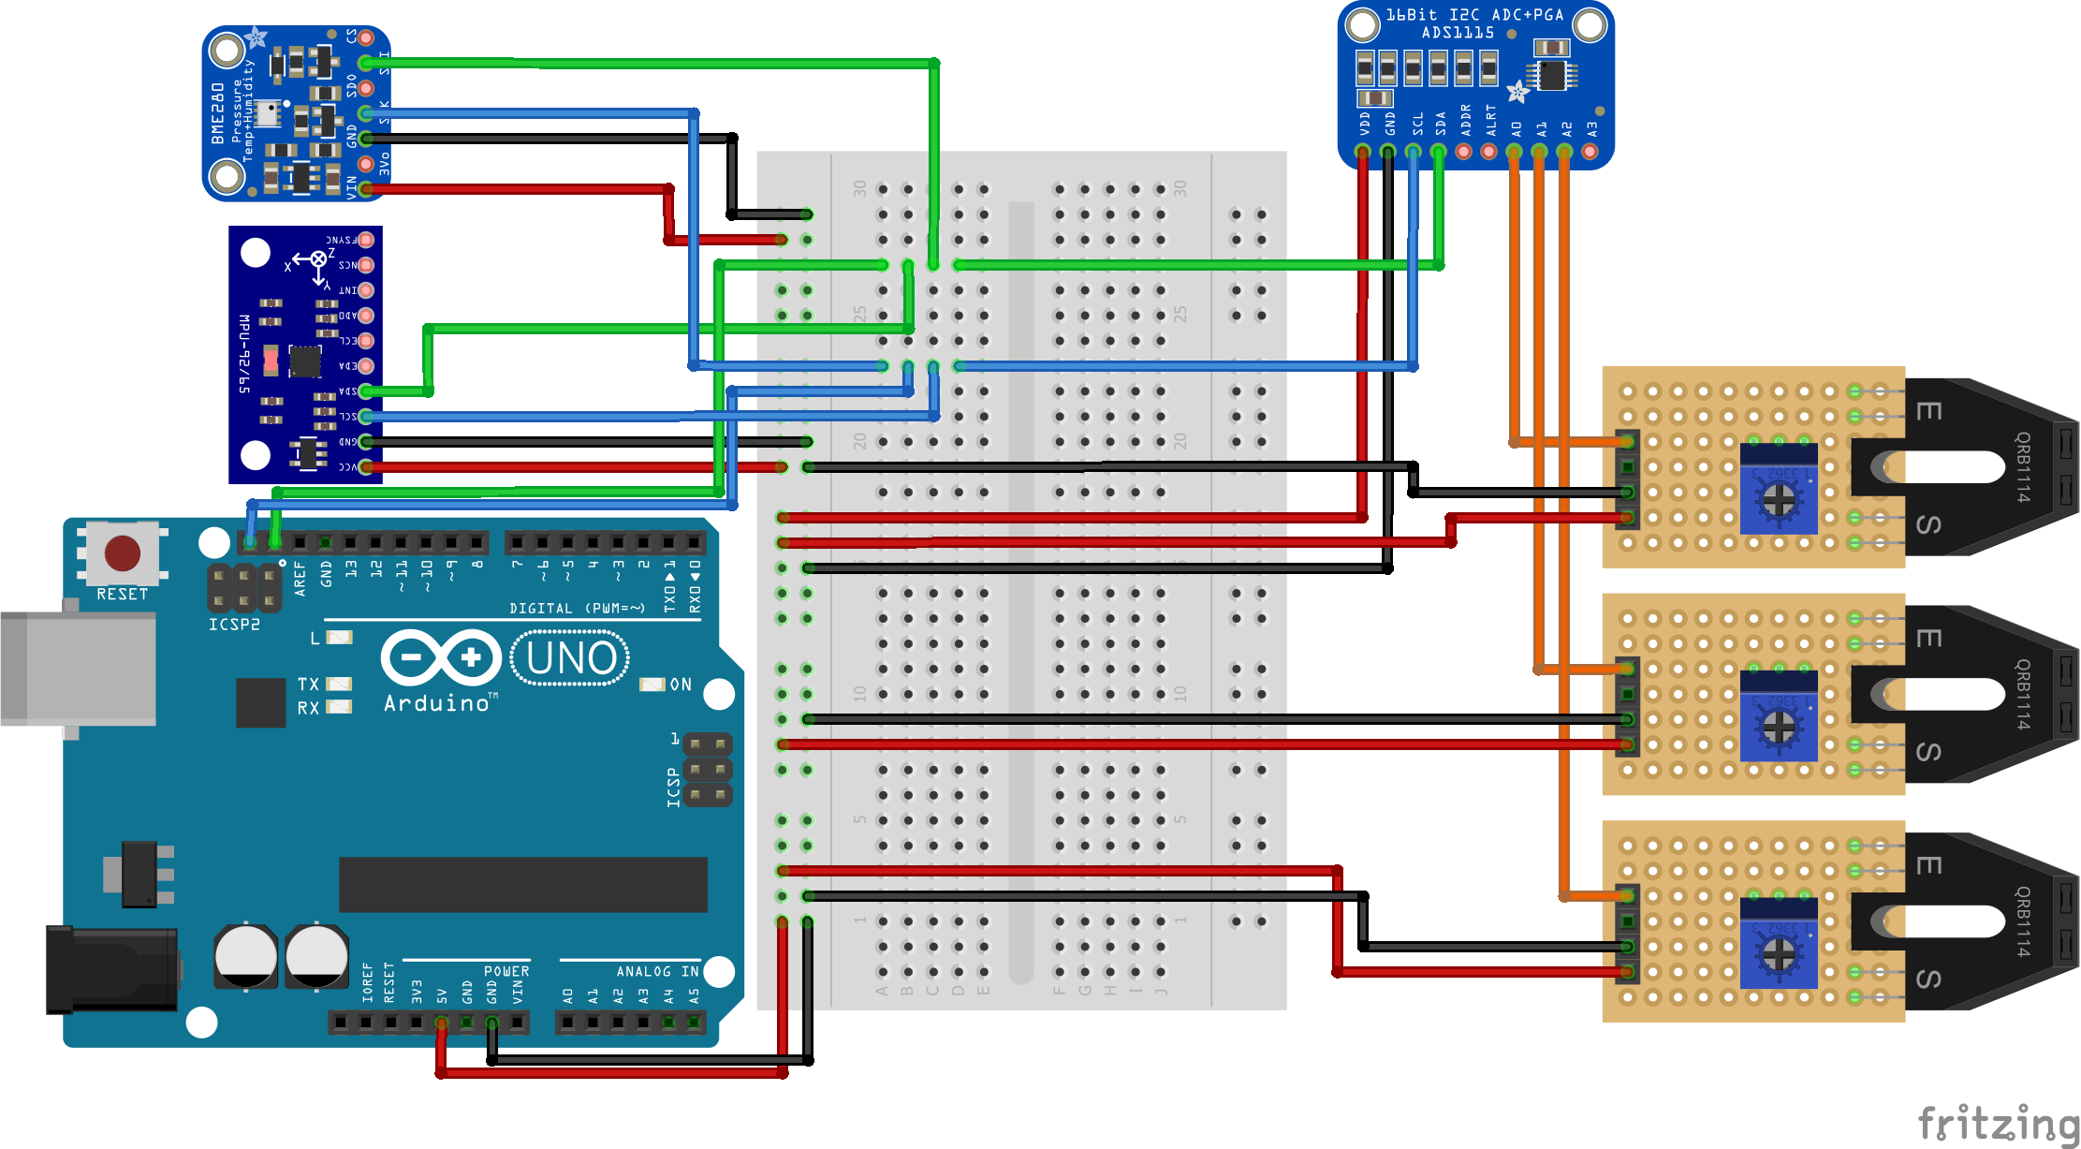

Slide 53
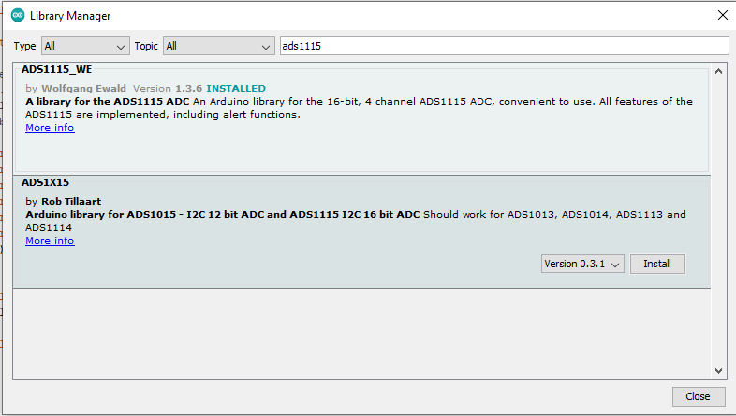

Slide 54
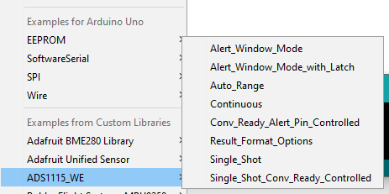
load an example

Slide 55
TASKS TO BE COMPLETED
  Download libraries for I2C sensors that you have
  Connect up sensors and use test programmes to check they are working
  Think about how you can make use of these I2C sensors for controlling your robot
  Try including them in a demonstration of the robot doing something

